Slide 1
Difference of
Two Proportions

Slide 2
Melting ice cap
Scientists predict that global warming may have big effects on the polar regions within the next 100 years. One of the possible effects is that the northern ice cap may completely melt. Would this bother you a great deal, some, a little, or not at all if it actually happened?
A great deal
Some
A little
Not at all

Slide 3
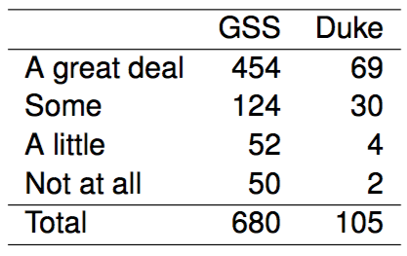
Results from the GSS
The General Social Survey (GSS) asks the same question, below are the distributions of responses from the 2010 GSS as well as from a group of introductory statistics students at Duke University:

Slide 4
Parameter and point estimate
Parameter of interest: Difference between the proportions of all Duke students and all Americans who would be bothered a great deal by the northern ice cap completely melting.
p_{Duke} - p_{US}

Slide 5
Parameter and point estimate
Parameter of interest: Difference between the proportions of all Duke students and all Americans who would be bothered a great deal by the northern ice cap completely melting.
p_{Duke} - p_{US}
Point estimate: Difference between the proportions of sampled Duke students and sampled Americans who would be bothered a great deal by the northern ice cap completely melting.
p̂_{Duke} - p̂_{US}

Slide 6
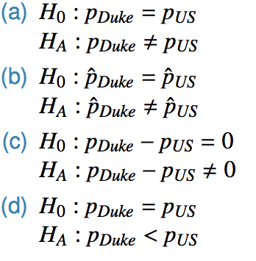
State your hypothesis
Which of the following is the correct set of hypotheses for testing if the proportion of all Duke students who would be bothered a great deal by the melting of the northern ice cap differs from the proportion of all Americans who do?

Slide 7
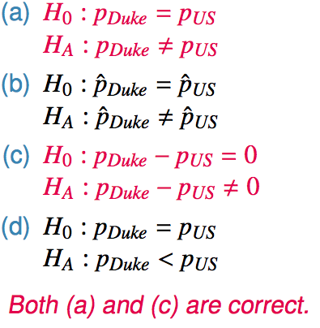
State your hypothesis
Which of the following is the correct set of hypotheses for testing if the proportion of all Duke students who would be bothered a great deal by the melting of the northern ice cap differs from the proportion of all Americans who do?

Slide 8
Condition of testing two proportions
Observations within each group or sample are independent.
Each sample is independent of the other.
In each group, the number of successes and failures are at least 10.

Slide 9


Inference for comparing proportions
We just need the appropriate standard error of the point estimate , which is the only new concept.
Standard error of the difference between two sample proportions

Slide 10

Pooled estimate of a proportion
In the case of comparing two proportions where H₀: p₁ = p₂, there is no difference in proportions between two groups.
Therefore, we can find a common (pooled) proportion for the two groups, and use that in our analysis.
This simply means finding the proportion of total successes among the total number of observations.
Pooled estimate of a proportion

Slide 11
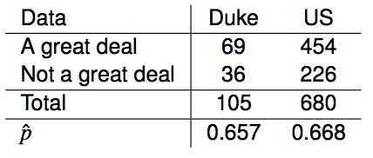
Practice
Calculate the estimated pooled proportion of Duke students and Americans who would be bothered a great deal by the melting of the northern ice cap. Which sample proportion (p̂_{Duke} or p̂_{US}) the pooled estimate is closer to? Why?

Slide 12

Pooled proportion
Calculate the estimated pooled proportion of Duke students and Americans who would be bothered a great deal by the melting of the northern ice cap. Which sample proportion (p̂_{Duke} or p̂_{US}) the pooled estimate is closer to? Why?

Slide 13
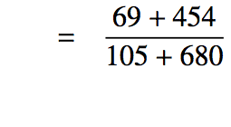


Pooled proportion
Calculate the estimated pooled proportion of Duke students and Americans who would be bothered a great deal by the melting of the northern ice cap. Which sample proportion (p̂_{Duke} or p̂_{US}) the pooled estimate is closer to? Why?

Slide 14
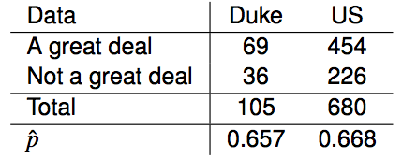
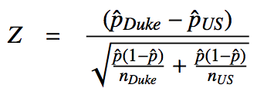
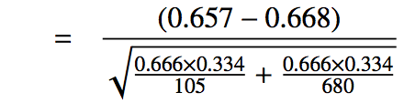
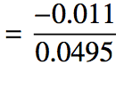
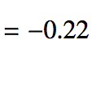
Z test statistic
Do these data suggest that the proportion of all Duke students who would be bothered a great deal by the melting of the northern ice cap differs from the proportion of all Americans who do? Calculate the test statistic, the p-value, and interpret your conclusion in context of the data.

Slide 15
P-value
Do these data suggest that the proportion of all Duke students who would be bothered a great deal by the melting of the northern ice cap differs from the proportion of all Americans who do? Calculate the test statistic, the p-value, and interpret your conclusion in context of the data.

Slide 16
Conclusion
Do these data suggest that the proportion of all Duke students who would be bothered a great deal by the melting of the northern ice cap differs from the proportion of all Americans who do? Calculate the test statistic, the p-value, and interpret your conclusion in context of the data.
Since p-value > significance level of 0.05, data does NOT suggest that the proportion of
all Duke students who would be bothered a great deal by the melting of the northern ice
cap differs from the proportion of all Americans who do.

Slide 17
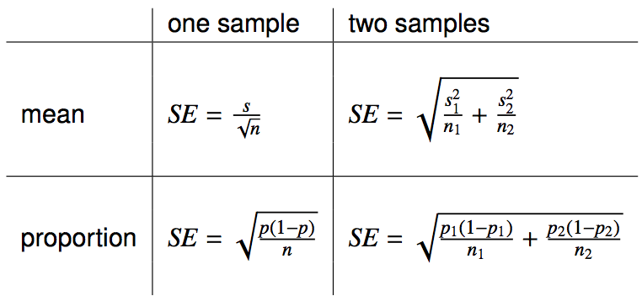
Reference - standard error
When working with means, it's very rare that σ is known, so we usually use s.

